Slide 1
More on Components
Introduction

Slide 2


Slide 3





Improving Our Components
Strong typing & interfaces
Encapsulating styles Lifecycle hooks Custom pipes
Nested components

Slide 4

Module Overview
Defining an interface
Encapsulating component styles Using lifecycle hooks
Building a custom pipe

Slide 5
Application Architecture
Welcome Component
index.html
App Component
Product List Component
Star Component
Product Detail Component
Product Data Service

Slide 6
Strong Typing
export class ProductListComponent { pageTitle: string = 'Product List'; showImage: boolean = false; listFilter: string = 'cart'; message: string;
products: any[] = […]; toggleImage(): void {
this.showImage = !this.showImage;
}
onRatingClicked(message: string): void { this.message = message;
}
}

Slide 7
An interface is a specification identifying a related set of properties and methods.

Slide 8
Two Ways to Use an Interface
export interface IProduct { productId: number; productName: string; productCode: string; releaseDate: string; price: number; description: string; starRating: number; imageUrl: string;
}
export interface DoTiming { count: number;
start(index: number): void; stop(): void;
}
As a feature set
export class myComponent
implements DoTiming {
count: number = 0; start(index: number): void {
...
}
stop(): void {
...
}
}
As a type
products: IProduct[] = [];

Slide 9
Declaring an Interface as a Data Type
export interface IProduct { productId: number; productName: string;
export
keyword
productCode: string; releaseDate: Date; price: number; description: string;
Interface name
starRating: number; imageUrl: string;
interface
keyword
}

Slide 10
Using an Interface as a Data Type
import { IProduct } from './product';
export class ProductListComponent { pageTitle: string = 'Product List'; showImage: boolean = false; listFilter: string = 'cart';
products: IProduct[] = […]; toggleImage(): void {
this.showImage = !this.showImage;
}
}

Slide 11
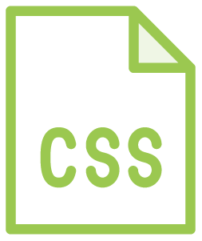
Handling Unique Component Styles
Templates sometimes require unique styles
We can inline the styles directly into the HTML
We can build an external stylesheet and link it in index.html
There is a better way!

Slide 12
Encapsulating Component Styles
@Component({
selector: 'pm-products',
templateUrl: './product-list.component.html', styles: ['thead {color: #337AB7;}']})
styles
@Component({
selector: 'pm-products',
templateUrl: './product-list.component.html', styleUrls: ['./product-list.component.css']})
styleUrls

Slide 13
Component Lifecycle
Create and render children
Process changes
Create
Render
Destroy

Slide 14
A lifecycle hook is an interface we implement to write code when a component lifecycle event occurs.

Slide 15

Component Lifecycle Hooks
OnInit: Perform component initialization, retrieve data
OnChanges: Perform action after change to input properties
OnDestroy: Perform cleanup

Slide 16
Using a Lifecycle Hook
import { Component, OnInit } from '@angular/core';
export class ProductListComponent implements OnInit { pageTitle: string = 'Product List';
showImage: boolean = false;
listFilter: string = 'cart'; products: IProduct[] = […];
ngOnInit(): void {
console.log('In OnInit');
}
}

Slide 17



Transforming Data with Pipes
Transform bound properties before display
Built-in pipes: date, number, decimal, percent, currency, json, etc.
Custom pipes

Slide 18
Building a Custom Pipe
import { Pipe, PipeTransform } from '@angular/core';
@Pipe({
name: 'convertToSpaces'
})
export class ConvertToSpacesPipe implements PipeTransform {
transform(value: string,
character: string): string {
}
}

Slide 19
Using a Custom Pipe
Template
<td>{{ product.productCode | convertToSpaces:'-’}}</td>
Pipe
transform(value: string, character: string): string {
}

Slide 20
BrowserModule
FormsModule
AppModule
AppComponent
ProductList - Component
ConvertToSpaces- Pipe
Imports Exports Declarations Bootstrap

Slide 21
Using a Custom Pipe
Template
<td>{{ product.productCode | convertToSpaces:'-'}}</td>
Module
@NgModule({ imports: [
BrowserModule, FormsModule ],
declarations: [
AppComponent, ProductListComponent, ConvertToSpacesPipe ],
bootstrap: [ AppComponent ]
})
export class AppModule { }

Slide 22



Getters and Setters
amount: number = 0;
get amount(): number {
// process the amount
// return amount from private storage
}
set amount(value: number) {
// process the amount
// retain amount in private storage
}

Slide 23
Getters and Setters
amount: number = 0;
private _amount: number = 0;
get amount(): number {
// process the amount
// return amount from private storage return this._amount;
}
set amount(value: number) {
// process the amount
// retain amount in private storage this._amount = value;
}

Slide 24
Getters and Setters
private _amount: number = 0;
get amount(): number {
// process the amount
// return amount from private storage return this._amount;
}
set amount(value: number) {
// process the amount
// retain amount in private storage this._amount = value;
}
this.amount = 200;
console.log(this.amount);

Slide 25
Filtering a List
products: IProduct[] = [...];
performFilter(): IProduct[] { return this.products.filter();
}

Slide 26
An arrow function is compact syntax for defining a function.

Slide 27
Filtering a List
products: IProduct[] = [...];
performFilter(): IProduct[] {
return this.products.filter((product: IProduct) => product.productName.includes(this.listFilter));
}

Slide 28
Arrow Functions
Classic named function (method)
capitalizeName(product: IProduct): string { return product.productName.toUpperCase();
}
Arrow function
(product: IProduct) => product.productName.toUpperCase();
Multi-statement arrow function
(product: IProduct) => { console.log(product.productName);
return product.productName.toUpperCase();
}

Slide 29

Interface Checklist: Interface as a Type
interface keyword
Properties and their types Export it
export interface IProduct { productId: number; productName: string; productCode: string;
...
}
Use the interface as a data type
products: IProduct[] = […];

Slide 30
Interface Checklist: Interface as a Feature Set
Implementing interfaces:
implements keyword & interface name
Write code for each property & method
import { Component, OnInit } from '@angular/core';
export class ProductComponent implements OnInit { ngOnInit(): void {
console.log('In OnInit');
}
}

Slide 31
Styles Checklist: Encapsulating Styles
styles property
Specify an array of style strings
styleUrls property
Specify an array of stylesheet paths
@Component({
selector: 'pm-products',
templateUrl: './product-list.component.html',
styleUrls: ['./product-list.component.css']})

Slide 32
Lifecycle Hook Checklist: Using Lifecycle Hooks
Import the lifecycle hook interface
Implement the lifecycle hook interface Write code for the hook method
import { Component, OnInit } from '@angular/core';
export class ProductComponent implements OnInit { ngOnInit(): void {
console.log('In OnInit');
}
}

Slide 33
Pipe Checklist: Building a Custom Pipe
Create a class that implements PipeTransform
Write code for the Transform method Decorate the class with the Pipe decorator
import { Pipe, PipeTransform } from '@angular/core';
@Pipe({
name: ‘spacePipe'
})
export class SpacePipe implements PipeTransform { transform(value: string,
character: string): string { ... }
}

Slide 34
Pipe Checklist: Using a Custom Pipe
Add the pipe to the declarations array of an Angular module
@NgModule({ imports: [...], declarations: [
AppComponent, ProductListComponent, SpacePipe ],
bootstrap: [ AppComponent ]
})
export class AppModule { }
Use the pipe in a template
Pipe character
Pipe name
Pipe arguments (separated with colons)
{{ product.productCode | spacePipe:'-'}}

Slide 35
Application Architecture
Welcome Component
index.html
App Component
Product List Component
Star Component
Product Detail Component
Product Data Service

Slide 36
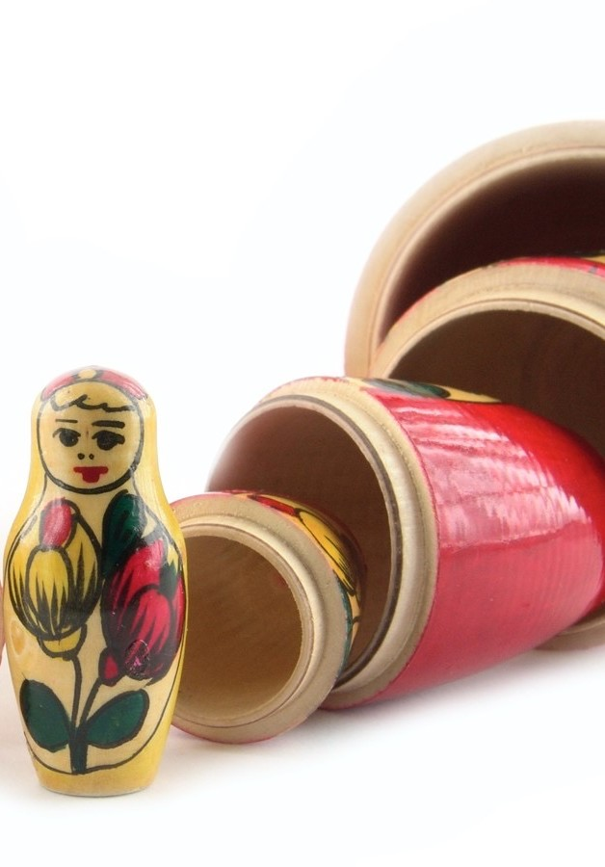
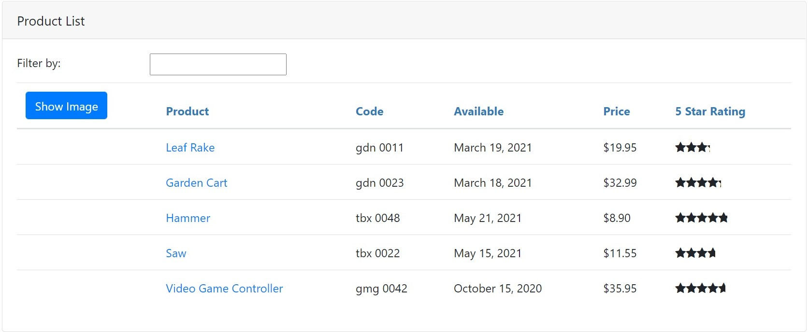
Coming up next …
Building Nested Components

